Slide 1

Real-time Machine Learning in Go
@OpenEnergi
Michael Bironneau
August 2016
Notes:
Before you start maybe say something about your background – it’s actually important here as data scientists don’t tend to come to Go that easily.
Background in pure maths
Started programming when I was 10 with a TI-83
Freelanced as web dev
First job was as a data analyst, then data scientist
Head of Technical Development at Open Energi

Slide 2
What is Machine Learning?

Slide 3
Definition by Category Theory
“A history monad whose underlying types form categories on which distributions are defined”
- Misquote of a Haskell ML library README
Notes:
The idea of “successive approximation” in the most general sense.

Slide 4

Definition by Image

Slide 5
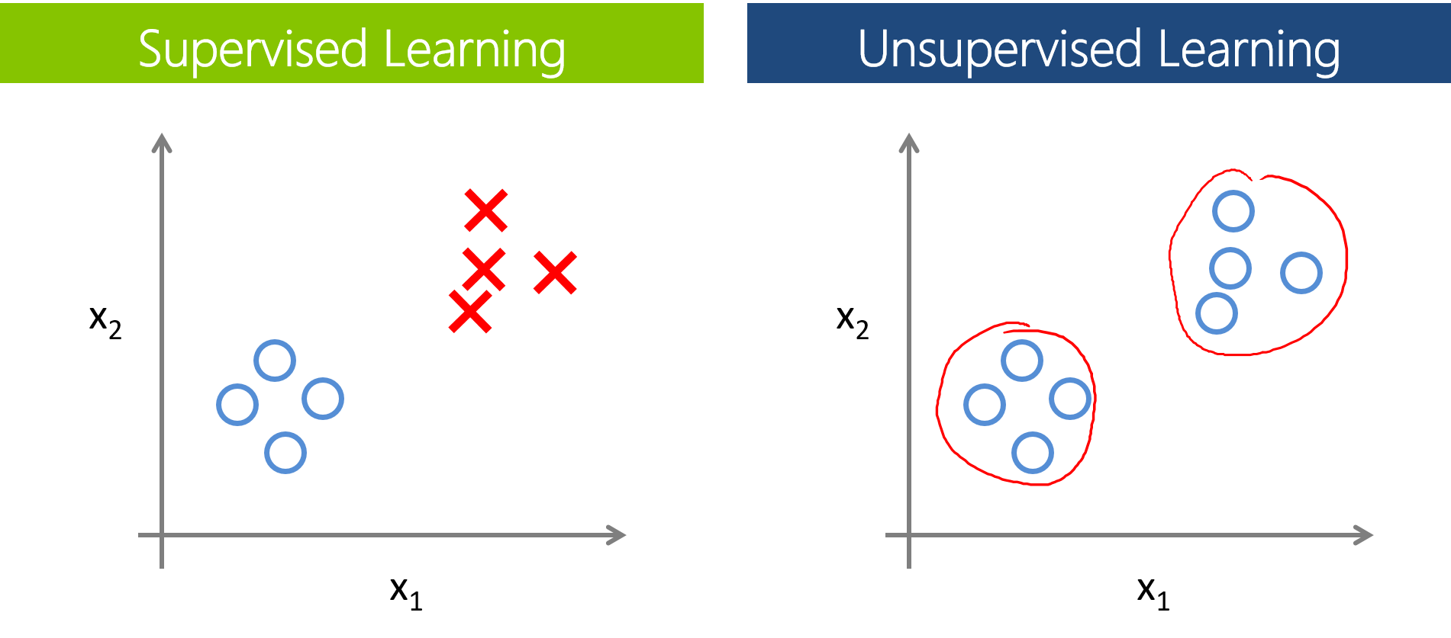
Definition by Classification
Supervised Learning
Unsupervised Learning
Reinforcement Learning
Illustration by Leonardo A. Santos http://bit.ly/2bCED7s
Notes:
Reinforcement example – monkeys experiment where they learn to beat the monkey that climbs the ladder to get the banana.

Slide 6
Definition by Process
Problem definition and pre-processing
Training
Validation
Persist and re-use
Notes:
Define data you’re interested in, normalize it, transform it, etc.
Train model on a part of your data set (the training set)
Validate the model by trying to predict labels of an unseen part of the data set (validation set)
Persist the fit parameters so that they can be re-used for further predictions.

Slide 7
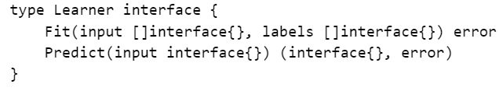

Definition by Interface
Gopher illustration by Tayuka Ueda (https://twitter.com/tenntenn)
Notes:
Note that labels can be nil.
Don’t like using blank interface{} but the underlying types can really be anything in this case (“categorical distribution”).
This is the “stateless” version, where trained models cannot be persisted for later re-use.

Slide 8
What do your machines learn?

Slide 9
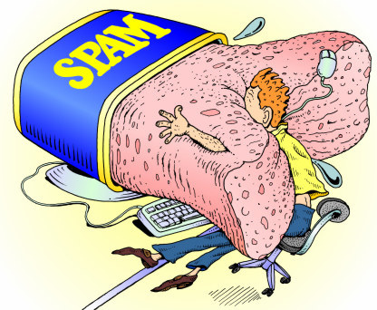
Stop the Spam 2000s(?)
Illustration by Diveraj (http://www.diveraj.com)
Notes:
The canonical example.

Slide 10

Spot the Cat(s) 2012
Image from Google Research (http://bit.ly/2b9HXoe)
Notes:
The trendy example. Unsurprisingly you can apply similar methods to other recognition tasks because an image is essentially just a vector.

Slide 11

Beat the Gamers 2015
Image from DeepMind (https://www.cs.toronto.edu/~vmnih/docs/dqn.pdf)

Slide 12
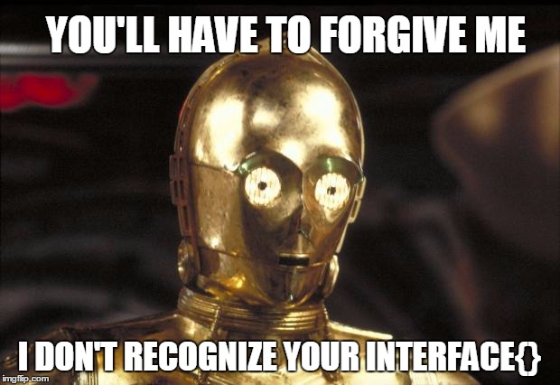
?? ????
Image from DeepMind (https://www.cs.toronto.edu/~vmnih/docs/dqn.pdf)

Slide 13
Machine Learning at Open Energi
Notes:
Let me digress briefly into what we do and why we’re interested in ML…

Slide 14
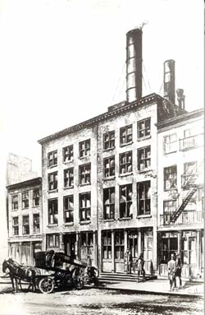
Image from Wiki Commons https://en.wikipedia.org/wiki/Pearl_Street_Station
Notes:
We are trying to improve the efficiency in power networks. About 20% at the time of the first power station – still only about 25% now.

Slide 15
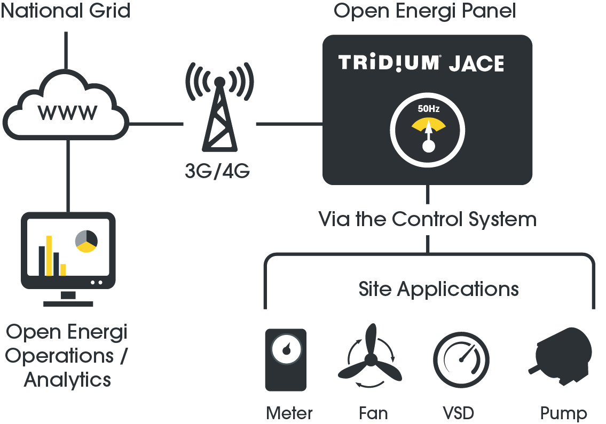

Slide 16
Notes:
Dynamic Demand can deliver approx £85,000 per MW/Yr
FCDM / Static FFR £22,000 - £26,000 per MW/Yr
STOR - £10,000 - £15,000 per MW/Yr

Slide 17
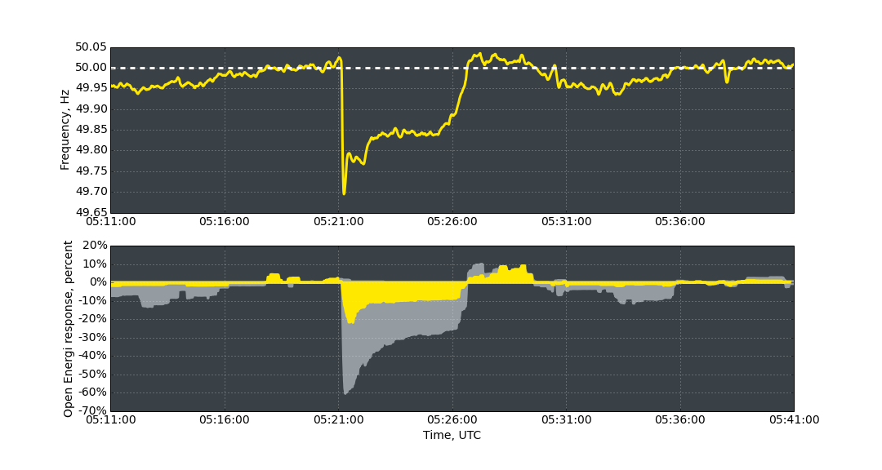
Notes:
- Open Energi is turning the energy system on it’s head, so that instead of supply adjusting to meet demand, demand adjusts to meet supply
By harnessing small amounts of flexible energy demand from energy-intensive equipment we can create a virtual power station and displace fossil-fuelled peaking power stations
This is enabling a user-led transformation in how our energy system works, so that businesses and consumers are not only making it happen, but also seeing the benefits
It’s a vital part of our transition to a zero carbon economy because we cannot maximise our use of renewables unless our demand for energy becomes more responsive

Slide 18
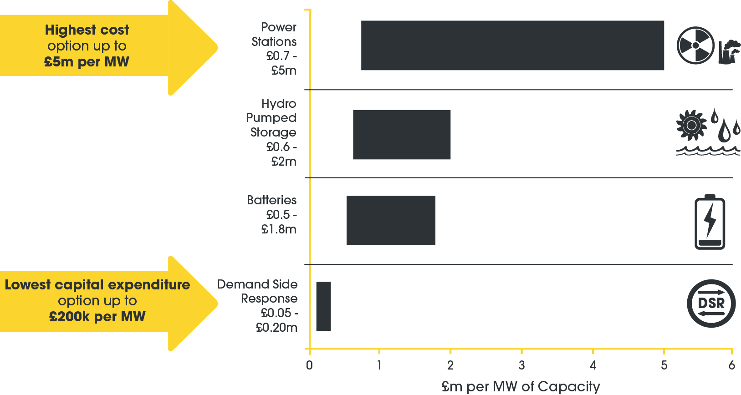
Notes:
There is a powerful economic case to distribute demand more efficiently using DSR technology, regardless of the future generation mix
The capital cost of building a new peaking power station can be up to £5 million per megawatt of power
The current costs to aggregate a megawatt via Dynamic Demand sit at around £200,000
It provides a no-build approach to capacity challenges which is cleaner, cheaper, more secure and faster than the alternatives.

Slide 19
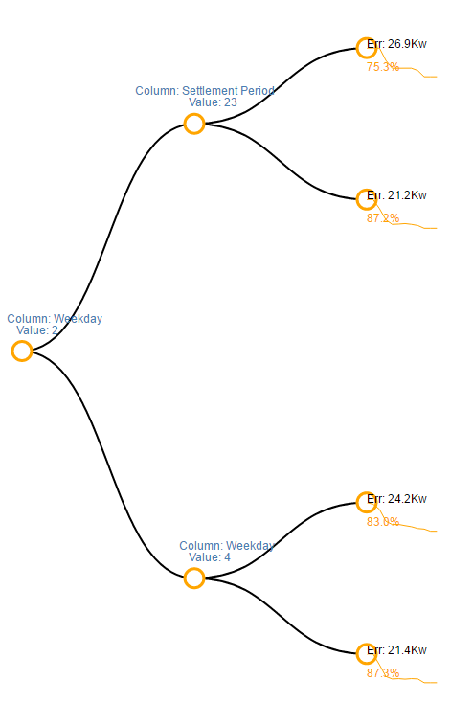
Load Behavior Forecasting
Notes:
Forecasting how much of our portfolio’s power consumption can be re-scheduled – at an asset-by-asset level.

Slide 20
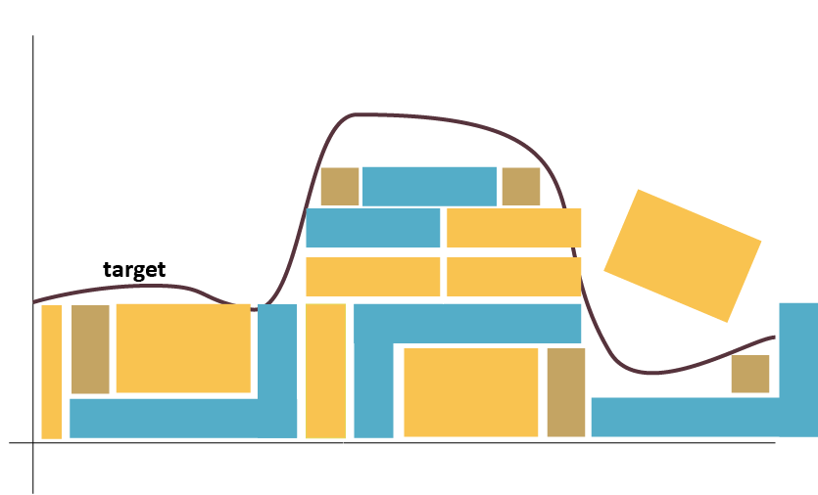
Value Modelling
Notes:
Playing tetris in real-time is not difficult – figuring out that there are different configurations and which one has which value requires a more subtle touch.

Slide 21
Get started!
Notes:
Let me digress briefly into what we do and why we’re interested in ML…

Slide 22

Go-Learn
https://github.com/sjwhitworth/golearn
Satisfies the Fit()/Predict() interface
“Batteries included”
Easy to learn coming from other frameworks (eg. Scikit-learn)
Can’t persist model parameters
Notes:
The full-Go approach.
Lots of pre-processing helpers.

Slide 23

Go-ML
https://github.com/cdipaolo/goml
Satisfies Learn()/Predict() interface
Little help with pre-processing
Easy to learn coming from other frameworks (eg. Scikit-learn)
Model parameters can be persisted!
Notes:
Handles persiss

Slide 24
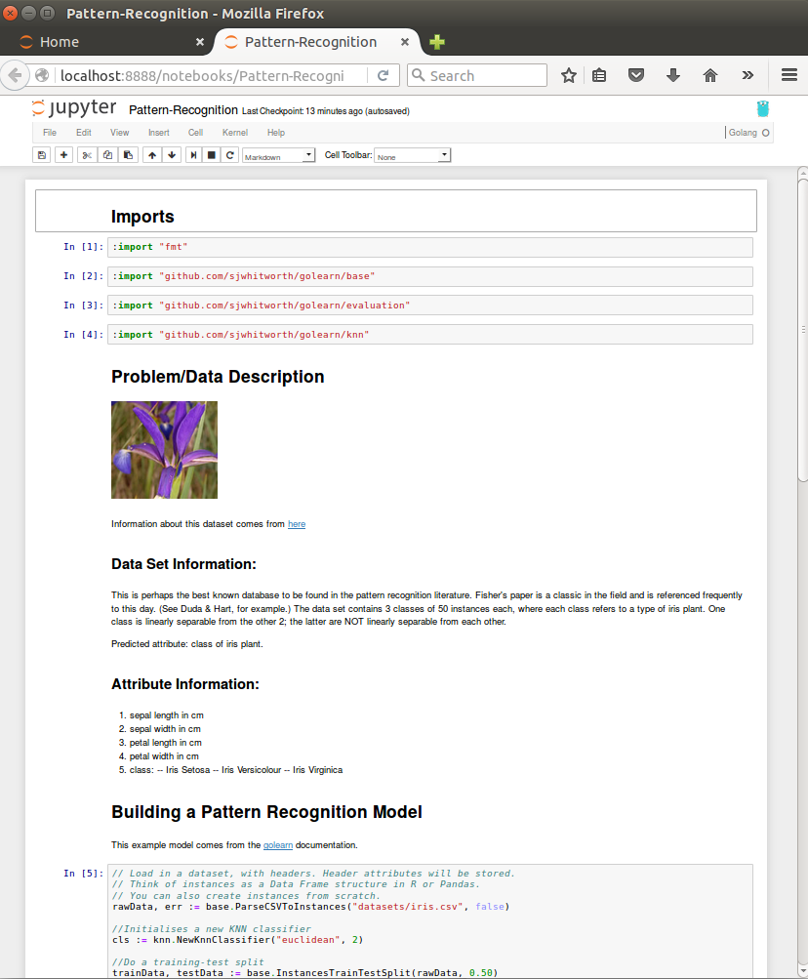
Use with gophernotes
Image from https://github.com/gopherds/gophernotes
Notes:
It’s better for interactive stuff, so you might as well use it with Jupyter…

Slide 25
16+ Other Packages Out There
https://github.com/josephmisiti/awesome-machine-learning#go
Notes:
Lots of other packages out there which have their pros and cons. Almost all of them satisfy the Fit()/Predict() interface.

Slide 26

Go bindings for popular frameworks
Tensorflow github.com/danieldk/tensorflow
Caffe github.com/wmyaoyao/gocaffe
Notes:
Or, you can try Go bindings for popular ML frameworks…these two came out earlier this year.

Slide 27

ML for the IoT with .
Notes:
IoT means models associated with Things, and that may be invalid as new data comes in. So the retraining has to be automatic.

Slide 28
Persistence
Notes:
Time is optional
Parameters should be version controlled

Slide 29
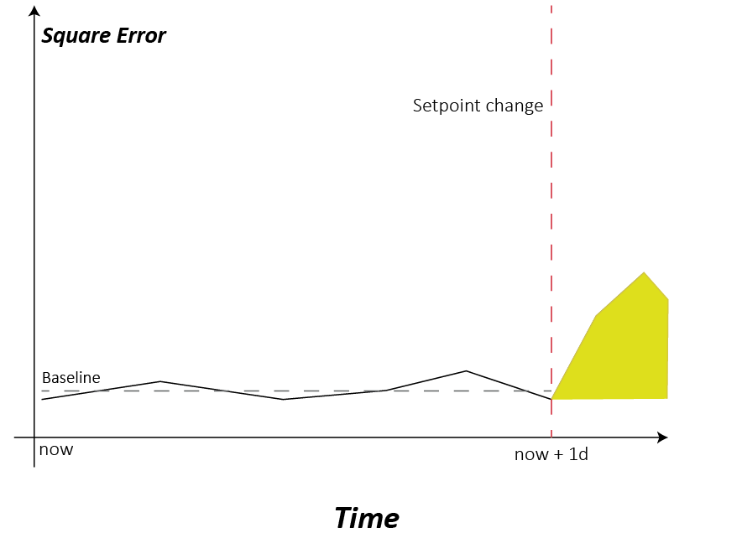
Streaming Data = Continuous Validation
Notes:
When we get new data and make predictions, we later get to correlate the actual value with what we had predicted.
Do anomaly detection – this is a well-understood problem and can do anomaly detection quite easily.

Slide 30
How do we run polyglot ML code in production?
Notes:
Let data scientists focus on the code and just provide the services that they need.

Slide 31
Data Scientist ≠ Software Engineer
Mathematical rigor
Accuracy
Ease of implementation
Scalability
Performance
Reliability
Notes:
There’s a human element to this if you work with data scientists.
Persistence of models/parameters
Re-training criteria
Handling errors
Data access and failures
CRUD of models

Slide 32

Step 1: os.Exec
Idea: Invoke ML model through os.Exec. Use JSON to marshal parameters back and forth.
Good: Easy to implement
Bad: Very slow
https://github.com/michaelbironneau/golanguk2016/tree/master/example1
Notes:
Easiest example. Essentially JSON-RPC through command line. Synchronous API. Doesn’t scale.

Slide 33
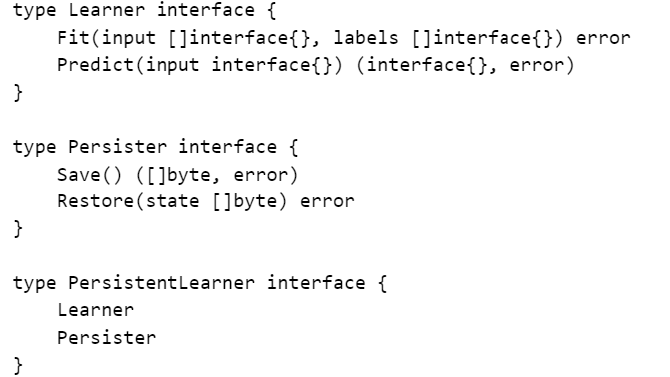
Stateful Interface
Notes:
Looks nice but implies side effects. Purely functional interface works better in practice.
This needs to be mirrored in the script – there needs to be “save” and “restore” command line flags.

Slide 34
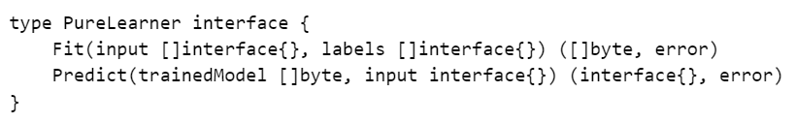
Pure Interface
State

Slide 35
Step 2: RPC Wrapper
Idea: Keep model running and invoke through RPC.
https://github.com/michaelbironneau/golanguk2016/tree/master/example2
Notes:
Requires some legwork on the Python side as well to expose the RPC server.
The example uses JSON-RPC.

Slide 36

Let’s put the “Things” back into IoT
Notes:
You would say: yes, but “thing” can just go inside the input. But this allows the caller to have more knowledge and this is important when doing validation and persistence.
Similarly you can add other “middlewares”.

Slide 37
Step 3: Microservice Wrapper
Idea: Still use RPC to make fit/training requests, but now use a framework like Go-Kit to add important features like short-circuiting, instrumentation and retry logic.
Notes:
We can do other things like sticky load balancing based on the “Thing” Id and throttling data access.

Slide 38
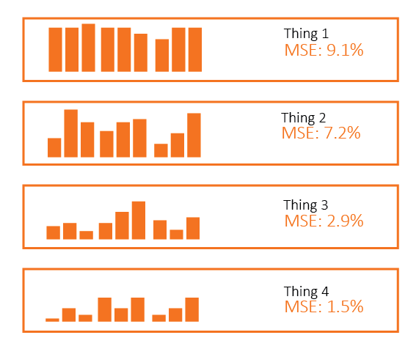
Step 4: Continuous Validation
Order of retraining
Notes:
The thing we want to get to…
Idea: Compare “real” Thing-timeseries to “predicted” Thing-timeseries, put the errors into a heap-like structure and have workers extract the max element.

Slide 39
Thanks for listening
Notes:
Not limited by storage cost – able to enrich data to reduce cost of processing
Ability to mix Python with SQL means easier/maintainable aggregation/downsampling
Interactive querying of multiple data sources with Spark in Jupyter
Easy ingestion process using multiple Flume agents
Can still use Elasticsearch for small timeseries

